Slide 1
ATHEX Market
Indices

Slide 2
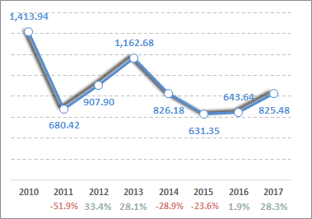
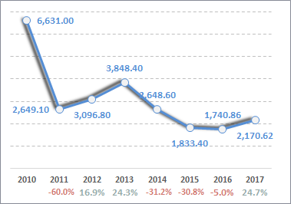
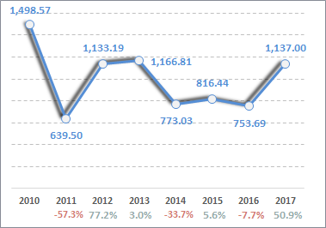
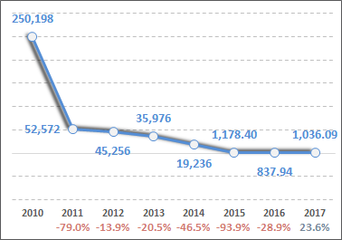
Market Returns Financial Sector Dominates Market Performance
Market returns for the period 2010-2017 have decline but not to the same extent for the individual segments of the market as this is offset by the returns of market indices
Compound Annual Growth Rate 2010 – 2017:
ATHEX Composite Index -7.4%
FTSE/ATHEX Large Cap Index -14.7%
FTSE/ATHEX Mid Cap -3.9%
FTSE/ATHEX Banking Index -53.0%
ATHEX Composite Price Index
FTSE/ATHEX Large Cap Index
FTSE/ATHEX Mid Cap Index
FTSE/ATHEX Banking Index
Source: ATHEXGROUP, August 31st 2017

Slide 3
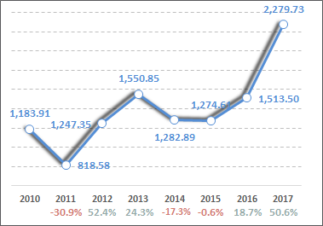
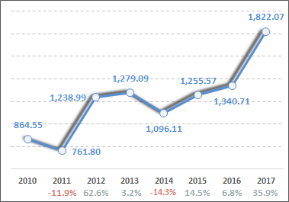
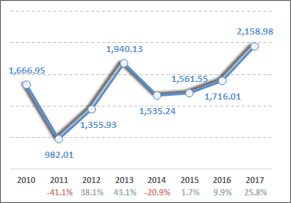
Market Returns Private Non Financial Sector Positive Returns
The private non financial sector showed greater resilience to the crisis with smaller losses compared to the banking sector and reacted faster when the climate in the economy showed signs of recovery.
Compound Annual Growth Rate 2010 – 2017:
FTSE/ATHEX Global Traders Plus +9.8%
FTSE/ATHEX Factor Weight +11.2%
ATHEX Price Index Ex-Banks +3.8%
From the 18 sector indices of the market only 2 have negative returns (Media -24.3% & Retail -19.6%) between 2014 and 2017
FTSE/ATHEX Global Traders Plus
FTSE/ATHEX Factor Weight
ATHEX Price Index Ex-Banks
Source: ATHEXGROUP, August 31st 2017

Slide 4
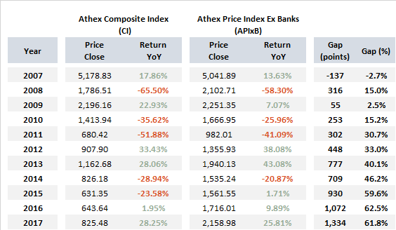
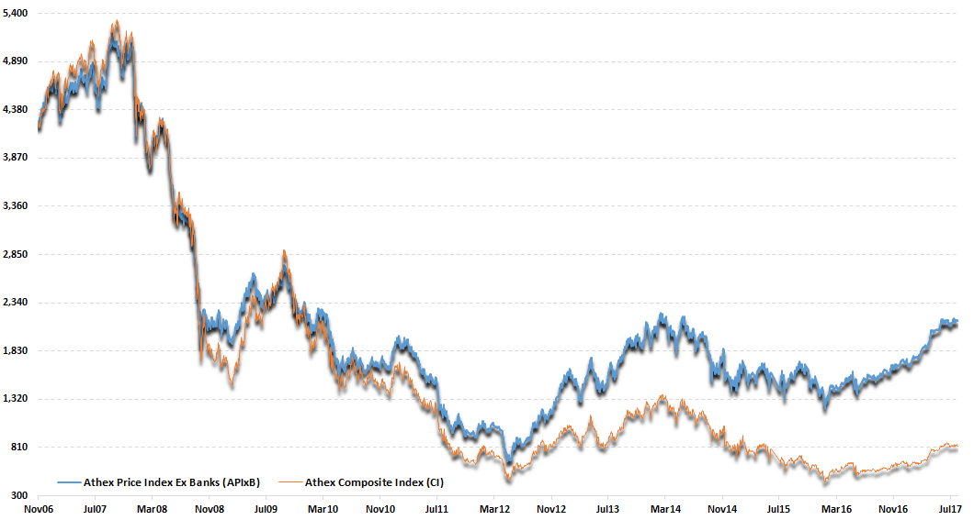
Comparative Market Yields Private Non Financial Sector Reveals the Difference
1,334
Source : ATHEX GROUP August 31st 2017

Slide 5
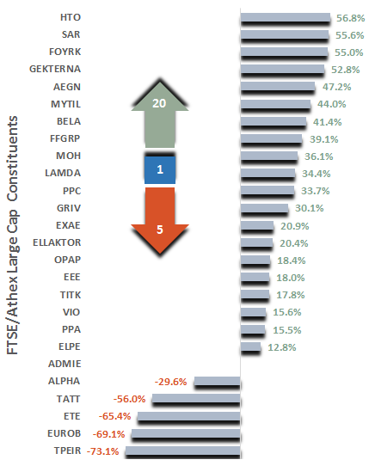
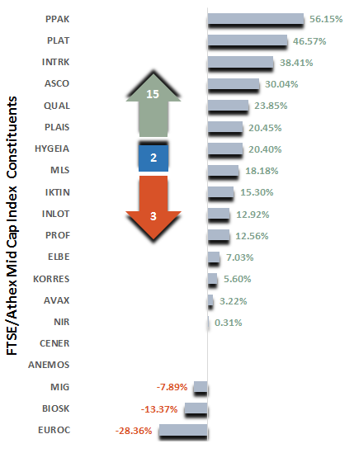
Extrovert Companies Have Reacted Faster From the Historical Low Prices of 2012
*
Compound Annual Growth Rate 2012 - 2017
Source : ATHEX GROUP August 31st 2017, * C.A.G.R. from low prices of June 5th 2012

Slide 6
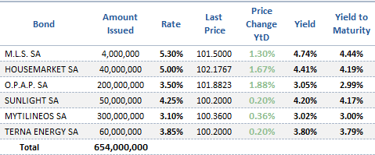
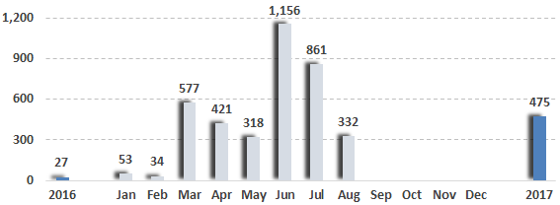
Corporate Bonds Optimistic Messages from Market Relaunch
New Corporate Bonds
Average Daily Trade Value
Hellenic Corporate Bonds Index
Source : ATHEX GROUP August 31st 2017, € thous

